Slide 1
Demo Setup
Android Designer Sample
https://github.com/jamesmontemagno/android-design-sample
Monkey Finder Code
https://github.com/jamesmontemagno/monkeyfinder6000
Xamarin.Essentials
https://aka.ms/xamarinessentials

Slide 3
Complete Mobile .NET Awesomeness
James Montemagno
Program Manager, Microsoft
@JamesMontemagno

Slide 4
James
Montemagno
Principal Program Manager – Mobile Developer Tools, Microsoft
motz@microsoft.com
Montemagno.com
@JamesMontemagno

Slide 5














Your platform for building anything
DESKTOP
WEB
CLOUD
MOBILE
GAMING
IoT
AI
.NET
Notes:
You can build anything with .NET. We’ve made significant investments in .NET over the years as well as unifying the ecosystem to support building literally anything.

Slide 6

Xamarin: Anything you can do in Objective-C, Swift, or Java, you can do in C# and Visual Studio
Native user interface
High-fidelity API access
Native performance
Notes:
This is one of the slides I love, as it really brings home some of the key points that make Xamarin tech so compelling.
Apps are built with standard, native user interface controls for easy and familiar interactions
Apps have access to the full spectrum of functionality exposed by the underlying platform and device.
Apps leverage platform-specific hardware acceleration, and are compiled as native binaries, not interpreted at runtime
But what are some of the new things we have brought to VS2017?
<<CLICK>>

Slide 7

.NET for Mobile Apps
iOS APIs
Android APIs
Windows APIs
Shared C# logic
Shared C# codebase • 100% native API access • High performance

Slide 8

.NET
Everywhere
Device native
.NET
Cloud native
.NET Everywhere
.NET STANDARD LIBRARY

Slide 9


Slide 10

Android Time! Demo

Slide 11
Less Pain Points

Slide 12
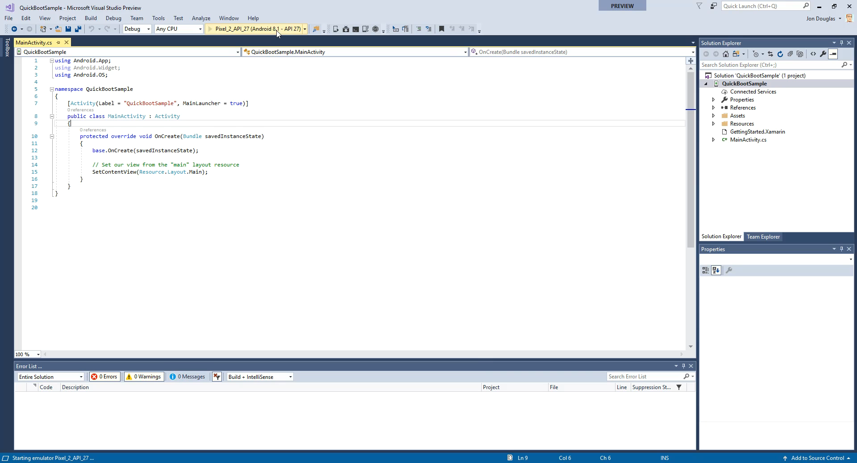
Android Emulator – Hyper-V + Quick Boot
Notes:
Boots your Android emulator in <6 seconds on subsequent boots.
Automatically enabled in Android emulators > 27.0.2
Between the Hyper-V support, device manager, and quick boot, I think this part of the story gets much better

Slide 13
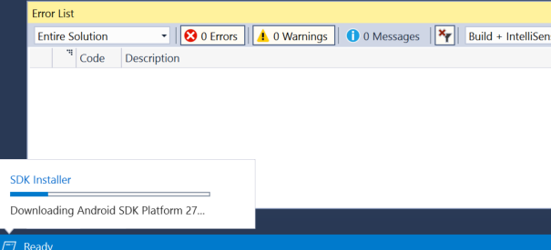
Automatic SDK Management

Slide 14
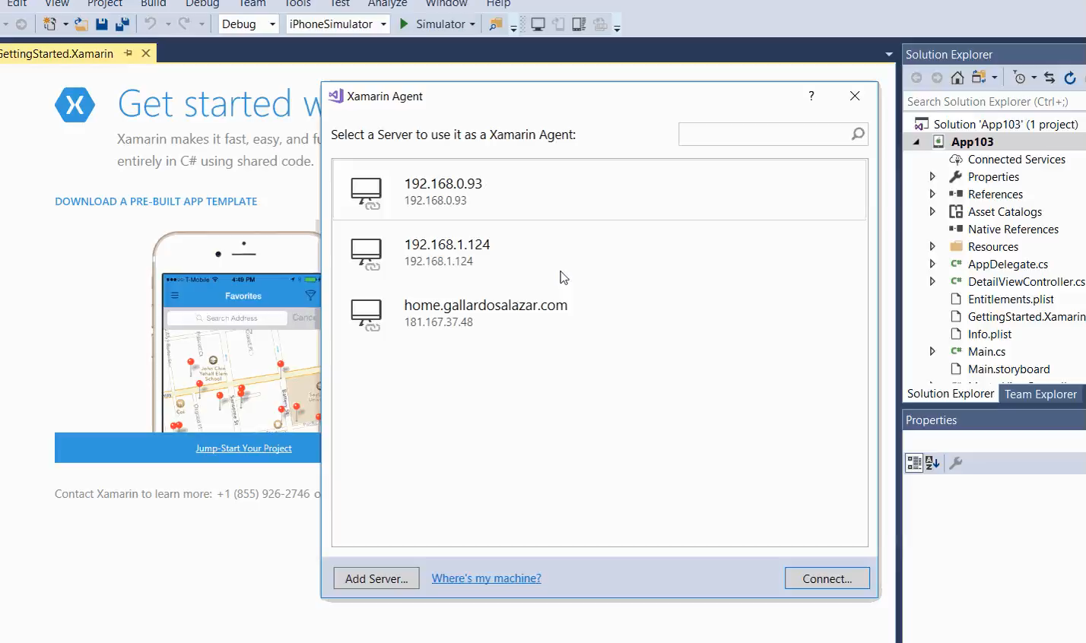
Provisioning your Mac

Slide 15
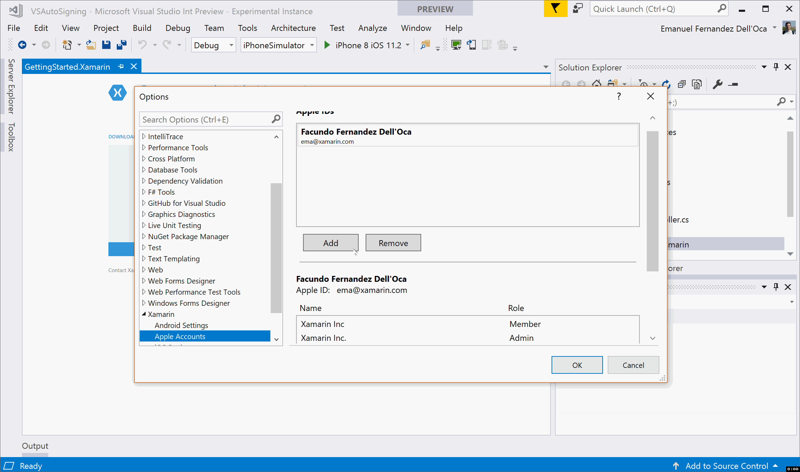
Automatic Device Provisioning

Slide 16
Cross-Platform

Slide 17
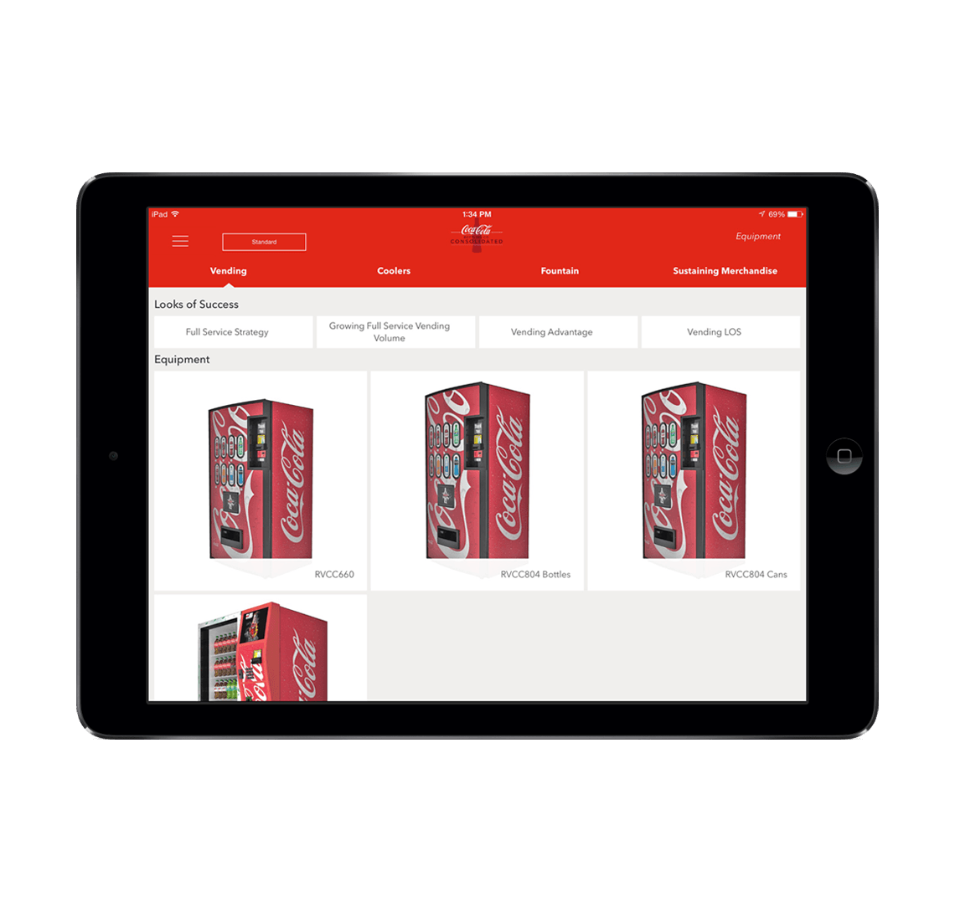
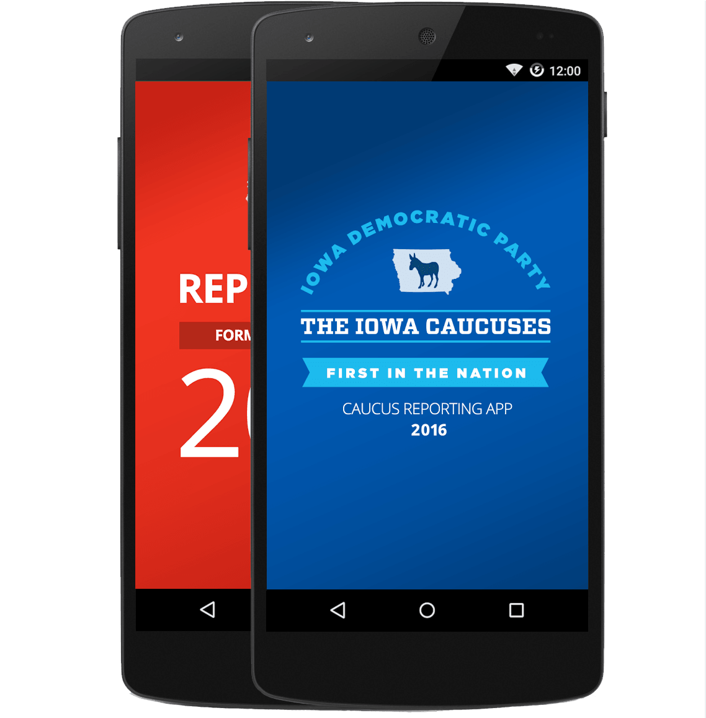
Xamarin.Forms- Cross Platform UI
Shared UI Code
Shared C# Logic
Shared Native User Interface
Shared App Logic

Slide 18
Let’s Build an App Demo

Slide 19
Native APIs

Slide 20
Geolocation
Geolocation
Geolocation
Shared C# Backend
Compass
Compass
Compass
Keystore
Keystore
Keystore
Notes:
When you think about architecting your apps you have a bulk of shared code, but still need to get to the native APIs which you can access in C#

Slide 21
Preferences.Get(“my_key”, 0);
NSUserDefaults
SharedPreferences
ApplicationData
Notes:
Here is an example of getting preferences:

Slide 22

Xamarin.Essentials
Secure Settings
Sms
Preferences
Flashlight
Clipboard
Gyroscope
Magnetometer
Geolocation
Phone Dialer
Device Display Info
Email
Device Info
Battery
Compass
Accelerometer
Screen Lock
Data Transfer
Text to Speech
Geocoding
File System
Connectivity
Vibration
aka.ms/xamarinessentials

Slide 23
Xamarin.Essentials Demo

Slide 24
.NET + Xamarin: Everything you need for mobile development

Slide 25
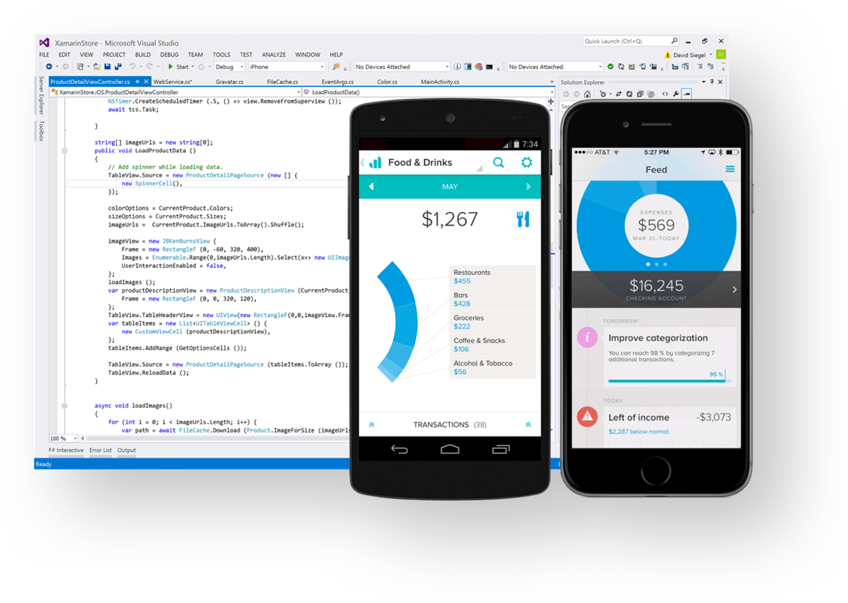
Visual Studio Tools for Xamarin
Xamarin.Essentials
visualstudio.com/xamarin
aka.ms/xamarinessentials

Slide 26


Weekly development podcast
mergeconflict.fm
Thank you.
Weekly development show
xamarinshow.com
James
Montemagno
Principal Program Manager – Mobile Developer Tools, Microsoft
motz@microsoft.com
Montemagno.com
@JamesMontemagno

